Slide 1
Virtual Reality Firefighter Training Simulation
Ragasri Padakanti
Nikita Bussa
Noampi Munipalli

Slide 2
GOAL AND OBJECTIVES:
The goal of this project is to create a virtual reality training simulation for firefighters that can help in providing feedback and coaching to users. Here we will simulate fire scenarios and provide feedback on how to respond to the situation.

Slide 3
MODELING:
In this project, we have created a realistic virtual environment that simulates a fire accident scenario. The environment will include a variety of objects like fire engine, fire fighters along with a city environment setup that includes buildings, traffic, vehicles etc.
The simulation will analyze the user behavior and provide feedback on how to respond to different scenarios.
This project will be developed using Unity.

Slide 4
The project will be divided into the following phases:
PHASE1:
Concept Design: In this phase, we will work with firefighters and fire experts to understand their training requirements and develop a design concept for the virtual environment. This will include creating a mood board, developing a color scheme, and creating a 3D model of the environment.

Slide 5
PHASE 2:
Environment Development: In this phase, we will use Unity to develop the virtual environment. This will involve creating a highly detailed and realistic representation of the fire scenario and hazards that firefighters would encounter in a real fire.

Slide 6
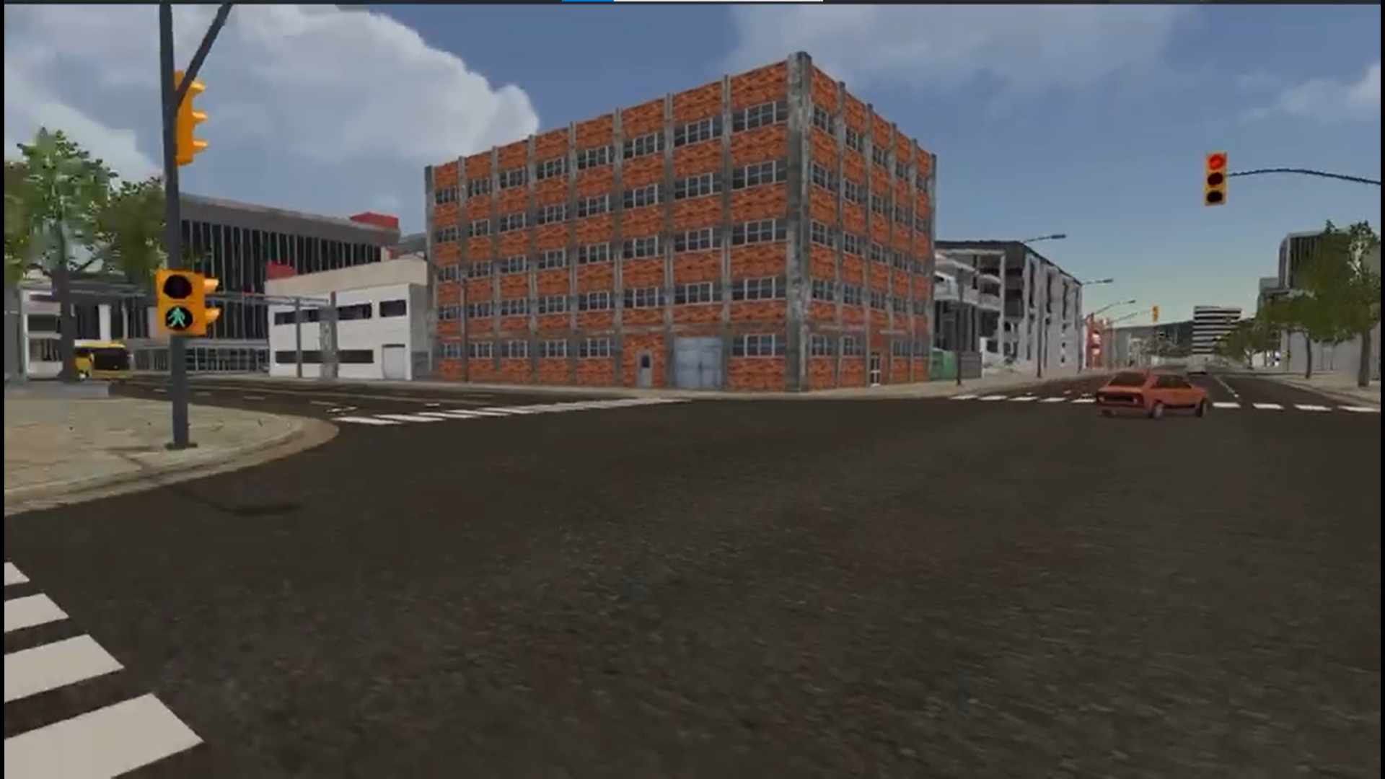

Slide 7
PHASE 3:
AI Integration: In this phase, we will integrate AI into the simulation. We will develop an AI model that can analyze user behavior and provide real-time feedback and coaching. We aim to develop an environment with the fire scenario and the reaction of firefighters to the situation.

Slide 8
PHASE 4:
Testing and Delivery: In this phase, we will test the virtual reality training simulation and make any necessary adjustments. We will also work with firefighters to deliver the final product and provide any necessary training on how to use the simulation.

Slide 9
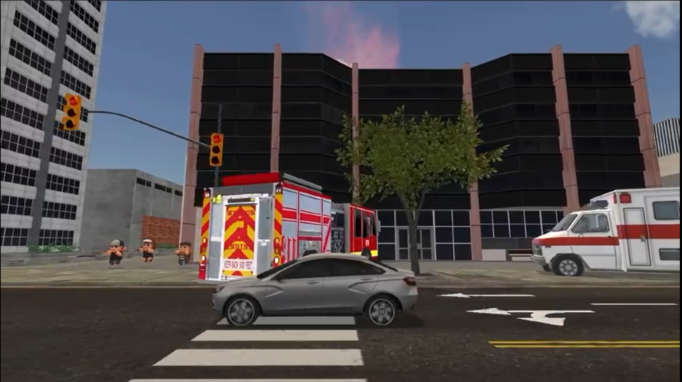

Slide 10
CONCLUSION
The simulation will be designed to provide a realistic and challenging training experience that prepares firefighters for real-life fire scenarios. The AI model will help firefighters improve their performance and develop the skills and knowledge they need to respond effectively to different types of fires and hazards.

Slide 11
THANK YOU

